Slide 1




HUSTHUB
School Management System
Login
Home About us News Events Contact
The system is designed and developed by GROUP 6
Get app HUSTHUB on mobile

Slide 2
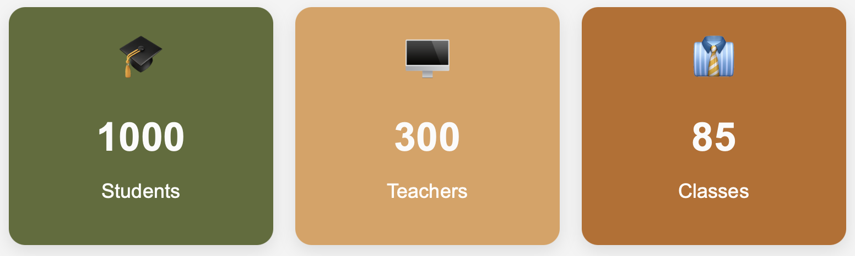
HUSTHUB
School Management System
Log out
Home Student Teacher Courses
GENERAL
NOTIFICATION
NOTIFICATION
The system is designed and developed by GROUP 6
Get app HUSTHUB on mobile

Slide 3
HUSTHUB
School Management System
Log out
Home Student Teacher Courses
Add new student
The system is designed and developed by GROUP 6
Get app HUSTHUB on mobile

Slide 4
HUSTHUB
School Management System
Log out
Home Timetable Courses
The system is designed and developed by GROUP 6
Get app HUSTHUB on mobile

Slide 5
HUSTHUB
School Management System
Log out
Home Timetable Classes
The system is designed and developed by GROUP 6
Get app HUSTHUB on mobile

Slide 6

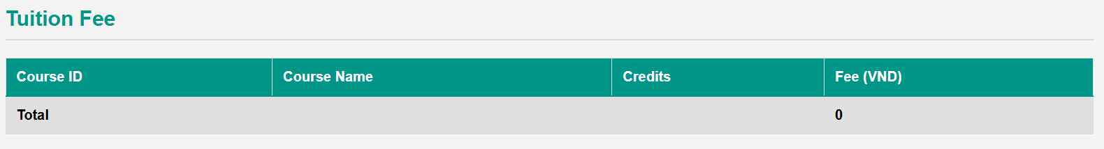
HUSTHUB
School Management System
Log out

Slide 7
HUSTHUB
School Management System
Log out

